Slide 1
Freshdesk Migration
Stakeholder Brief

Slide 2
Overview
Benefits
Objectives
Approach
Migration Plan

Slide 3

Overview
Freshdesk is a powerful cloud-based help desk solution with an easy to use user interface. Suited for small to medium businesses, it can help deliver the required customer service experience as it is straightforward to use.
Freshdesk is best suited if you:
Want a quick setup without lengthy settings and configurations.
Prefer ease of use over extensive customization (still possible).
Want simple collaboration tools.
Want one window solution for all helpdesk needs.

Slide 4
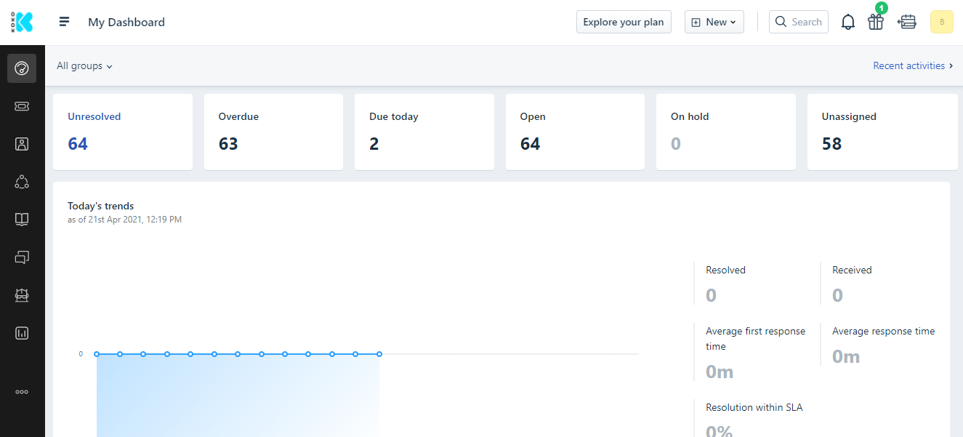
Overview (Dashboard)

Slide 5
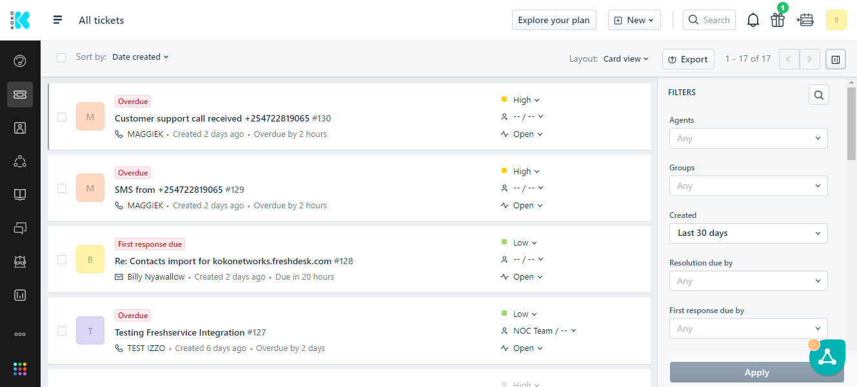
Overview (Tickets)

Slide 6
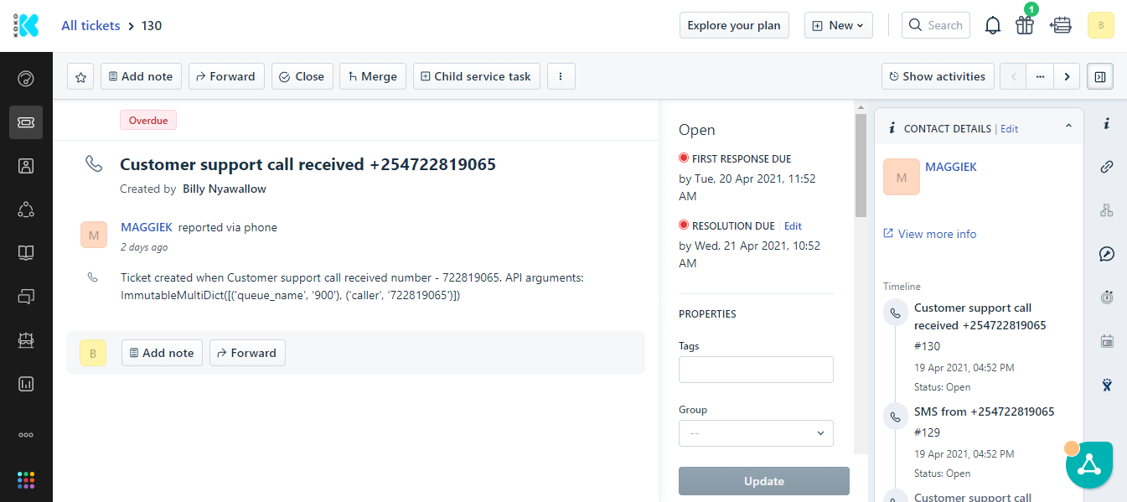
Overview (Ticket Details)

Slide 7
Benefits Of Freshdesk
Simpler, more productive UI/UX for support staff
Cross channel customer support from a single user interface
Native integration with WhatsApp saves on the cost of Ongair ($100+/month).
Intelligent ticket management features increase CC agent productivity.
Improved collaboration between CC, NOC and Engineering teams.
Easy access to customer information from one platform
Comprehensive curated and custom reporting suitable for analytics and business intelligence
Reduced complexity integrating with external services
Freshdesk is more affordable than Zendesk (details in the next slide)

Slide 8
Benefits Of Freshdesk
Price Comparison between Freshdesk and Zendesk
FRESHDESK (ESTATE) | ZENDESK (SUITE TEAM)
Estate Plan (50 seats x $49) | Support Professional Subscription (48 seats x $59)
Field Service Management (6 seats x $29) | Support: Collaboration Subscription (48 seats x $25)
WhatsApp integration (1 unit x $49) | Ongair ($149)
Total (monthly): $2,673 | Total (monthly): $4,181

Slide 9
Objectives For Migration
Provide CCRs with unified access to the customer support information.
Remove duplicate/orphaned customer data from the support pipeline.
Provide robust integrations with customer support channels
Synchronize customer data with KOKO Core to ensure up to date information.
Better integration of CC with Network Operations (NOC) and Technical Reliability
Build clean, relevant reports and dashboards for KOKO CC operations
To ensure that CC operations still work effectively without breaking previous settings

Slide 10
Approach
ITEM | DETAILS | STATUS
Freshdesk preliminary testing & Zendesk comparison | Set up demo accounts Compare Freshdesk and Zendesk platform features | COMPLETE
Freshdesk setup/configuration | Setup customer form fields Setup ticket form fields Setup automations in Freshdesk Setup triggers in Freshdesk Setup macros in Freshdesk Setup SLAs in Freshdesk Setup refined CC tags in Freshdesk | COMPLETE
Freshdesk migration preps | Conduct Freshdesk CC stakeholders brief Reset Freshdesk to remove test data Migrate all customer data from KC to Freshdesk Create CC agents user accounts in Freshdesk Develop Freshdesk training manual Train CC test agents in Freshdesk Set up daily Freshdesk reports | IN PROGRESS

Slide 11
Approach
ITEM | DESCRIPTION | STATUS
Freshdesk migration | Migrate the Zendesk WhatsApp channel to Freshdesk Migrate the Zendesk SMS channel to Freshdesk Migrate the Zendesk Call channel to Freshdesk | NOT STARTED
Post migration | Train remaining CC agents in Freshdesk Migrate all CC agents to Freshdesk Assign caretaker agents to close remaining Zendesk tickets or Jira issues Decommission Zendesk Setup reports in Freshdesk | NOT STARTED

Slide 12
Not Importing Historical Data (Rationale)
Historical data is defined as ticket data collected within the Zendesk platform and include:
Support tickets (Resolved/Active)
CC agents (Inactive/Active)
KOKO Customers (Registered/Unregistered)
Several issues can be faced when handling historical data:
A huge number of tickets are orphaned (not linked to active CC agents)
Many CC agents are no longer employees/active Zendesk users
Several customers within Zendesk are not registered customers
There are a lot of duplicate customer records (using different phone numbers)
A lot of these issue have resulted in customer support histories which are not well defined, as well as duplicate data that cannot be used for analytical purposes nor have significant business value. For this reason, in order to collect well defined, organized data for the future, it is necessary to disregard importing historical data into Freshdesk and start afresh with valid customer data from KOKO Core.
The plan is to archive historical data in case it’s required in the future.

Slide 13
Migration Acceptance Criteria
The objective is to successfully migrate KOKO customer support to Freshdesk. The acceptance criteria for this objective are:
Validate customer data from KOKO Core in Freshdesk
CCRs are competent in using the Freshdesk platform
Create new support tickets in Freshdesk
Generate support tickets from WhatsApp chats
Update ticket details in Freshdesk
Ticket response times should be in line with CC SLAs
Synchronize customer data for new customers in Freshdesk
Escalate & synchronize customer tickets with Freshservice
Link customer tickets with new/existing Jira issues
Generate support tickets from customer calls (Queuemetrics)
Generate support tickets from customer SMS (KOKO Core)

Slide 14
Proposed Migration Plan
The proposed migration plan is intended to guide the preparation of Freshdesk for use by Customer Care (CC) and should be completed before May 10 2021, subject to CC buy in and agreement.
The plan encompasses the following steps:
Customer Care preps (CC requirements)
Freshdesk platform setup (platform configuration)
Pre-migration preps (cleanup tasks)
Migration of WhatsApp support
Migration of SMS support
Migration of Call support
The detailed migration plan is available at this LINK.

Slide 15
Freshdesk Migration Phases
WhatsApp Migration:
This is the initial migration step.
Trigger: Successful migration preparations
REQUIREMENTS | DETAILS | STATUS
Assign migration agents | Assign 5 migration agents to work on the migration process (LINK) | COMPLETE
Disabling WhatsApp integration in Zendesk | Disable the WhatsApp for Business integration in Zendesk | NOT STARTED
Linking the Freshdesk to KOKO production account. | Link Freshdesk to the KOKOK production WhatsApp for Business account (100%) | NOT STARTED

Slide 16
Freshdesk Migration
2. SMS Migration:
This is the second migration step. Trigger: Successful testing of WhatsApp migration
REQUIREMENTS | DETAILS | STATUS
Assign migration agents | Assign 5 migration agents to work on the migration process (LINK) | COMPLETE
Set ticket volume to 10% | Set the Freshdesk SMS ticket volume to 10% in KOKO Core | NOT STARTED
Set ticket volume to 25% | Set the Freshdesk SMS ticket volume to 25% in KOKO Core | NOT STARTED
Set ticket volume to 50% | Set the Freshdesk SMS ticket volume to 50% in KOKO Core | NOT STARTED
Transition all SMS traffic to Freshdesk | Set Freshdesk SMS ticket volume to 100% in KOKO Core | NOT STARTED

Slide 17
Freshdesk Migration
3. Call Migration:
This is the third migration step. Trigger: Successful testing of SMS migration
REQUIREMENTS | DETAILS | STATUS
Assign migration agents | Assign 5 migration agents to work on the migration process (LINK) | COMPLETE
Set ticket volume to 10% | Set the Freshdesk Call ticket volume to 10% in KOKO Core | NOT STARTED
Set ticket volume to 25% | Set the Freshdesk Call ticket volume to 25% in KOKO Core | NOT STARTED
Set ticket volume to 50% | Set the Freshdesk Call ticket volume to 50% in KOKO Core | NOT STARTED
Transition all SMS traffic to Freshdesk | Set Freshdesk Call ticket volume to 100% in KOKO Core | NOT STARTED

Slide 18
Freshdesk Migration Roadmap
PHASE | DETAILS | DURATION | SCHEDULE | STATUS
1 | WhatsApp channel migration | 10 days | 10/5/2021 - 21/5/2021 | NOT STARTED
2 | SMS channel migration | 10 days | 24/5/2021 - 4/6/2021 | NOT STARTED
3 | Call channel migration | 10 days | 7/6/2021 - 18/6/2021 | NOT STARTED
Selected Freshdesk migration CC agents selected are 5 vs 9 CC agents on Zendesk. Selected migration agents are available in this list (LINK)
N/B: The duration of each phase is subject to change based on the challenges faced during migration.

Slide 19
Roadmap/next steps
When Freshdesk migration is complete, the following features will need to be implemented next:
FEATURE | PRIORITY | NOTES
Cooker field visit scheduling within Freshdesk | HIGH
Set up Freshdesk productivity automations | MEDIUM
WhatsApp chatbots | MEDIUM
Social media integration (Facebook, Twitter) | LOW
Chatbots to support KOKO websites | LOW

Slide 20
k.nyawallow@kokonetworks.com

